Slide 1
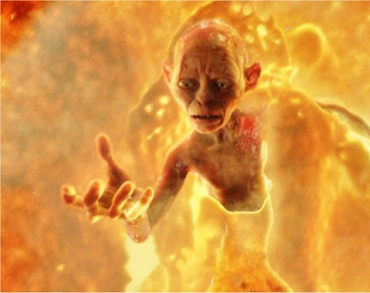
Animating Viscous Fluid Using A Globular Particle System
Leevon Levasseur CSC 473
Based on the paper by:
Gavin Miller & Andrew Pearce

Slide 2
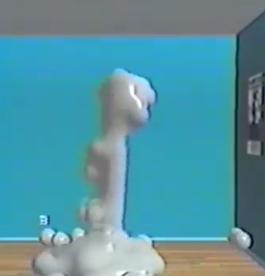
Globular Dynamics: A Connected Particle System for Animating Viscous Fluids [Gavin Miller et Andrew Pearce]
Model viscous fluid including Lava, Mud, Slime, etc.
Ad hoc liquid method that does not require Naiver Stokes.
Use soft gloppy particles in a physical-based simulator.
Soft collisions.
Form relationships between particles based on distance,
Similar to flocks [C. W. Reynolds].
Control over material:
Powder,
Liquid,
Solid.
Lacks detail regarding variable values and testing.

Slide 3
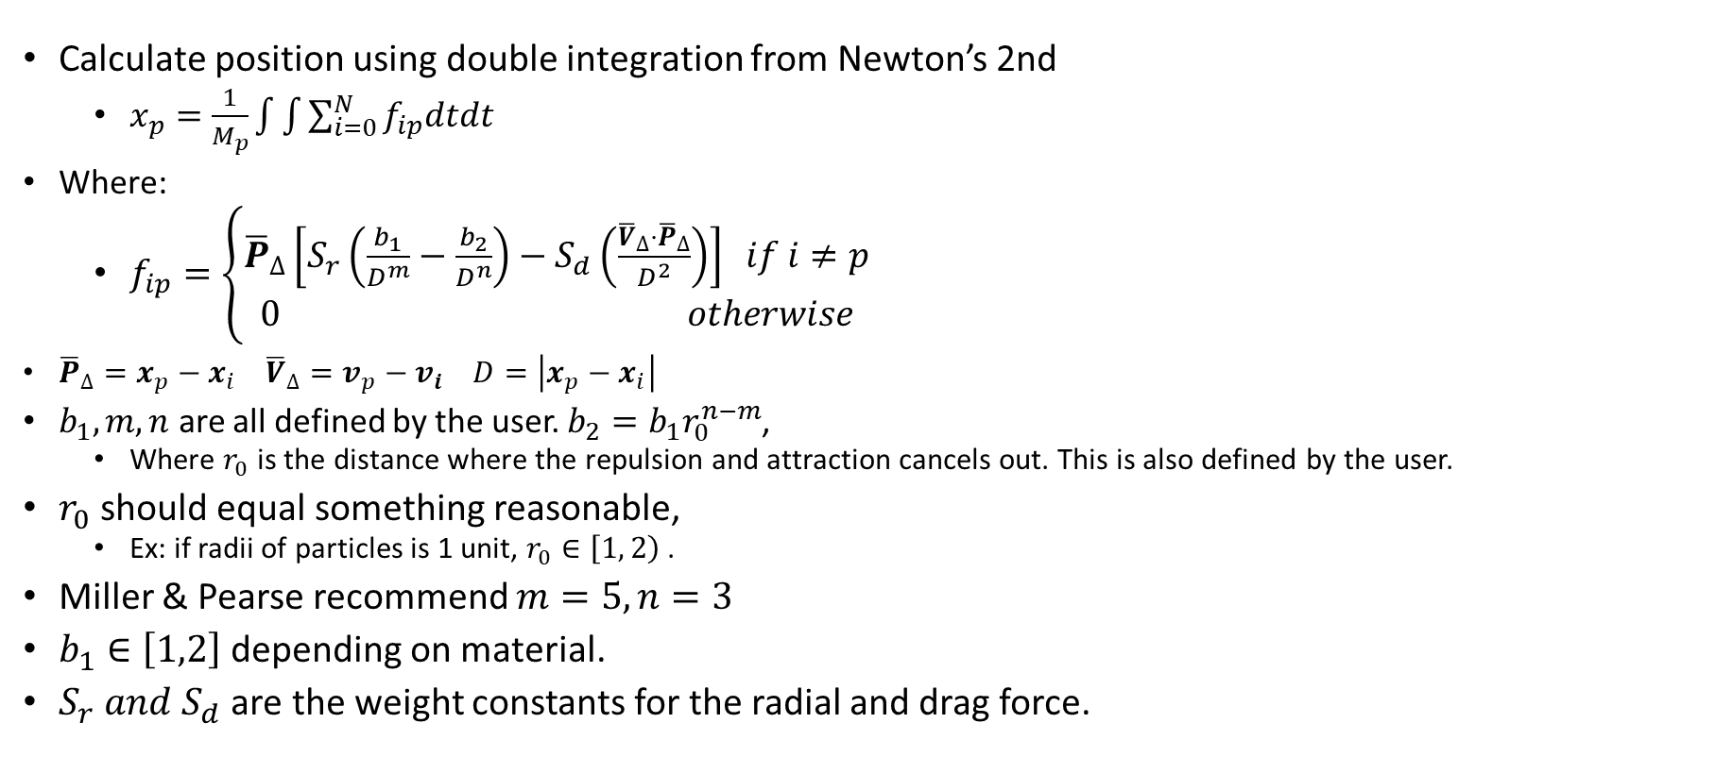
Interglobular Force
Calculate position using double integration from Newton’s 2nd
$x_{p}=\frac{1}{M_{p}}\int{\int{\sum_{i=0}^{N}{f_{ip}dtdt}}}$
Where:
$f_{ip}=\left\{\begin{aligned}{\overline{P}}_{∆}\left[S_{r}\left(\frac{b_{1}}{D^{m}}−\frac{b_{2}}{D^{n}}\right)−S_{d}\left(\frac{{\overline{V}}_{∆}⋅{\overline{P}}_{∆}}{D^{2}}\right)\right] if i≠p \\ 0 otherwise\end{aligned}\right.$
${\overline{P}}_{∆}=x_{p}−x_{i}$ ${\overline{V}}_{∆}=v_{p}−v_{i}$ $D=\left|x_{p}−x_{i}\right|$
$b_{1}, m, n$ are all defined by the user. $b_{2}=b_{1}r_{0}^{n−m}$,
Where $r_{0}$ is the distance where the repulsion and attraction cancels out. This is also defined by the user.
$r_{0}$ should equal something reasonable,
Ex: if radii of particles is 1 unit, $r_{0}∈\left[1, \left.2\right)\right.$ .
Miller & Pearse recommend $m=5, n=3$
$b_{1}∈\left[1,2\right]$ depending on material.
$S_{r} and S_{d}$ are the weight constants for the radial and drag force.
r

Slide 4
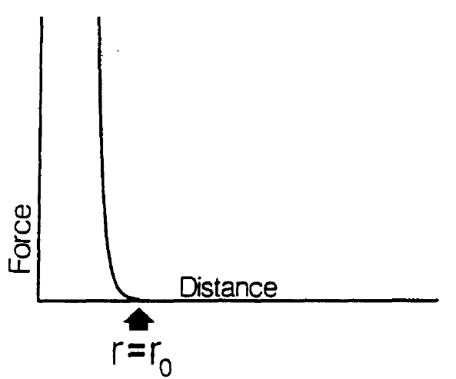
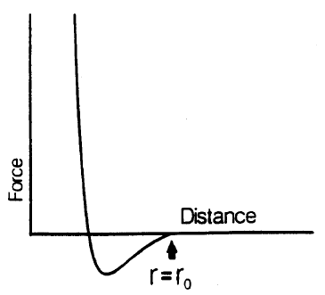
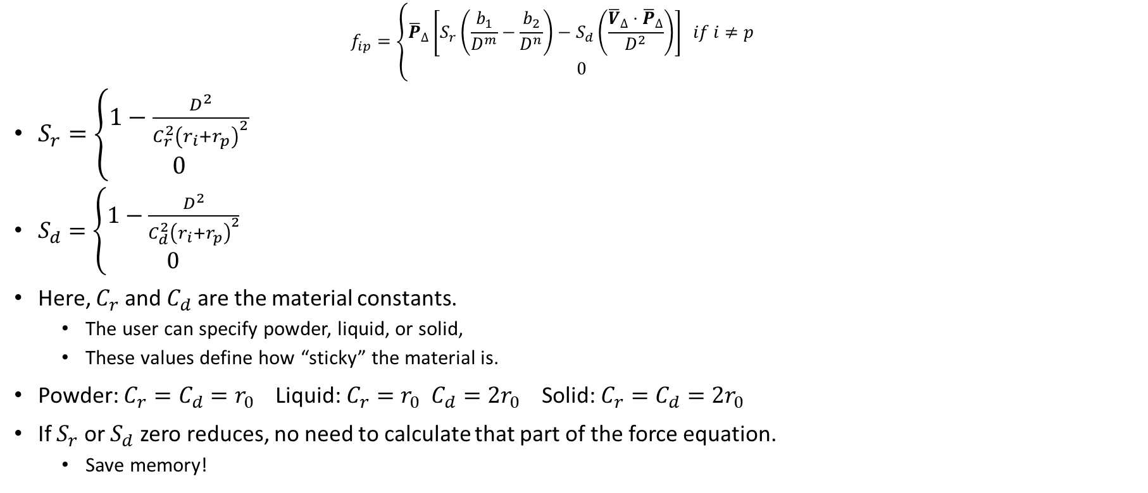
Repulsion/Attraction & Drag Weights
$$f_{ip}=\left\{\begin{aligned}{\overline{P}}_{∆}\left[S_{r}\left(\frac{b_{1}}{D^{m}}−\frac{b_{2}}{D^{n}}\right)−S_{d}\left(\frac{{\overline{V}}_{∆}⋅{\overline{P}}_{∆}}{D^{2}}\right)\right] if i≠p \\ 0\end{aligned}\right.$$
$S_{r}=\left\{\begin{aligned}1−\frac{D^{2}}{C_{r}^{2}{\left(r_{i}+r_{p}\right)}^{2}} \\ 0\end{aligned}\right.$
$S_{d}=\left\{\begin{aligned}1−\frac{D^{2}}{C_{d}^{2}{\left(r_{i}+r_{p}\right)}^{2}} \\ 0\end{aligned}\right.$
Here, $C_{r}$ and $C_{d}$ are the material constants.
The user can specify powder, liquid, or solid,
These values define how “sticky” the material is.
Powder: $C_{r}=C_{d}=r_{0}$ Liquid: $C_{r}=r_{0} C_{d}={2r}_{0}$ Solid: $C_{r}=C_{d}={2r}_{0}$
If $S_{r}$ or $S_{d}$ zero reduces, no need to calculate that part of the force equation.
Save memory!
otherwise
if
otherwise
if
otherwise
Powder & Liquid Force Distribution
Solid Force Distribution

Slide 5
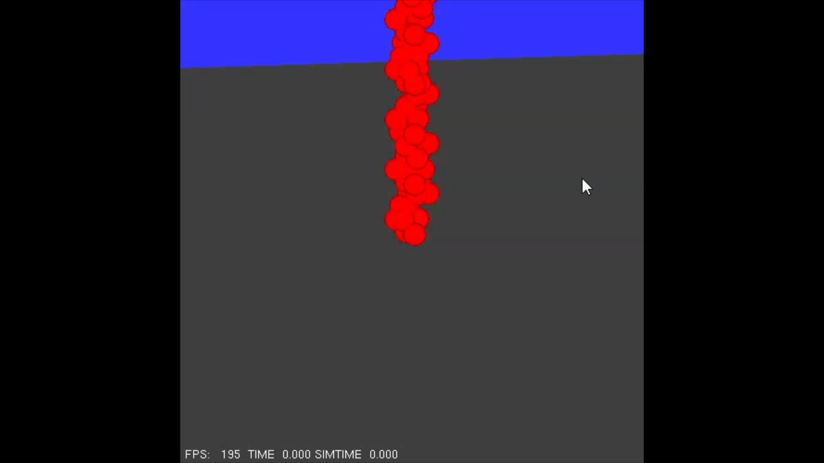
Simulation
Forward Euler approach to solve for the next position of a particle.
A very small Time Step is required to avoid exploding particles,
0.001 seconds was used for demos.
FPS depends on how many particles are in the system,
NVIDIA GTX 3070 Super, Ryzen 5 3600xt, 16g RAM, Windows 10:
~120fps – 200 Globules,
~60fps – 400 Globules.
Using C++, OpenGL, AnimTcl:
A dedicated system to store globule information,
A simulator that computes force and next position.
Initialize particles with noise in their x, z position, otherwise:
Globules that are only influenced by gravity tend to stack,
Globules that overlap to close will explode, have enough space between,
A helix formation was used to simply have a different x, z for each globule,
A flow from a spout is the idea.
Impulse collision with objects; the ground plane in the demo.

Slide 6
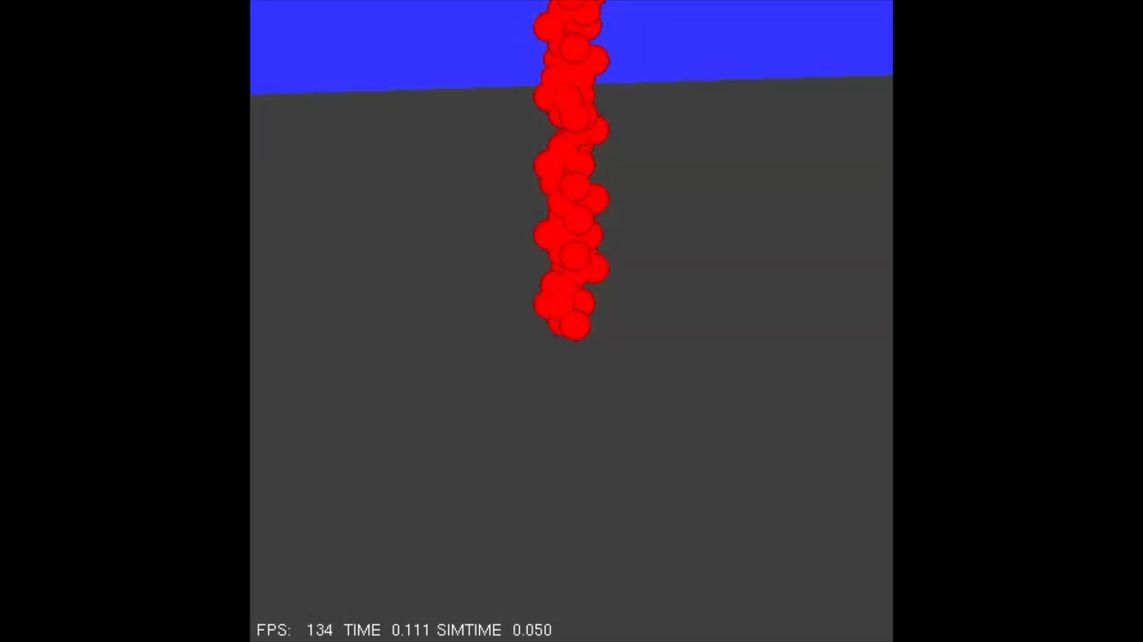
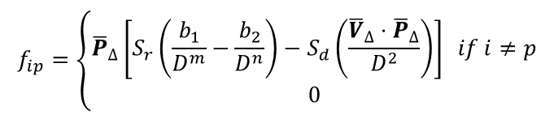
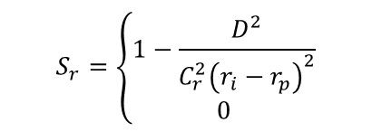
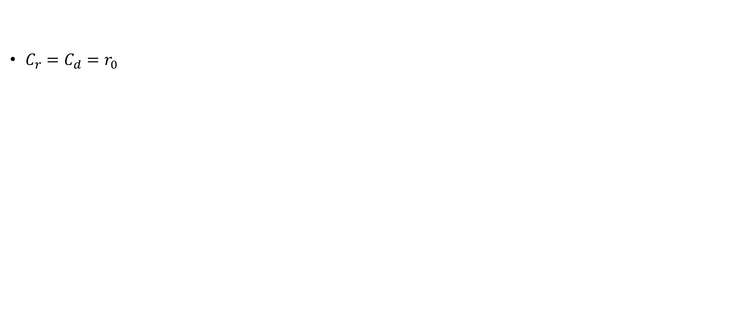
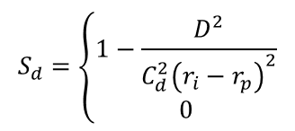
Powder
$$f_{ip}=\left\{\begin{aligned}{\overline{P}}_{∆}\left[S_{r}\left(\frac{b_{1}}{D^{m}}−\frac{b_{2}}{D^{n}}\right)−S_{d}\left(\frac{{\overline{V}}_{∆}⋅{\overline{P}}_{∆}}{D^{2}}\right)\right] if i≠p \\ 0\end{aligned}\right.$$
otherwise
$$S_{r}=\left\{\begin{aligned}1−\frac{D^{2}}{C_{r}^{2}{\left(r_{i}−r_{p}\right)}^{2}} \\ 0\end{aligned}\right.$$
$$S_{d}=\left\{\begin{aligned}1−\frac{D^{2}}{C_{d}^{2}{\left(r_{i}−r_{p}\right)}^{2}} \\ 0\end{aligned}\right.$$
$C_{r}=C_{d}=r_{0}$
otherwise
otherwise

Slide 7

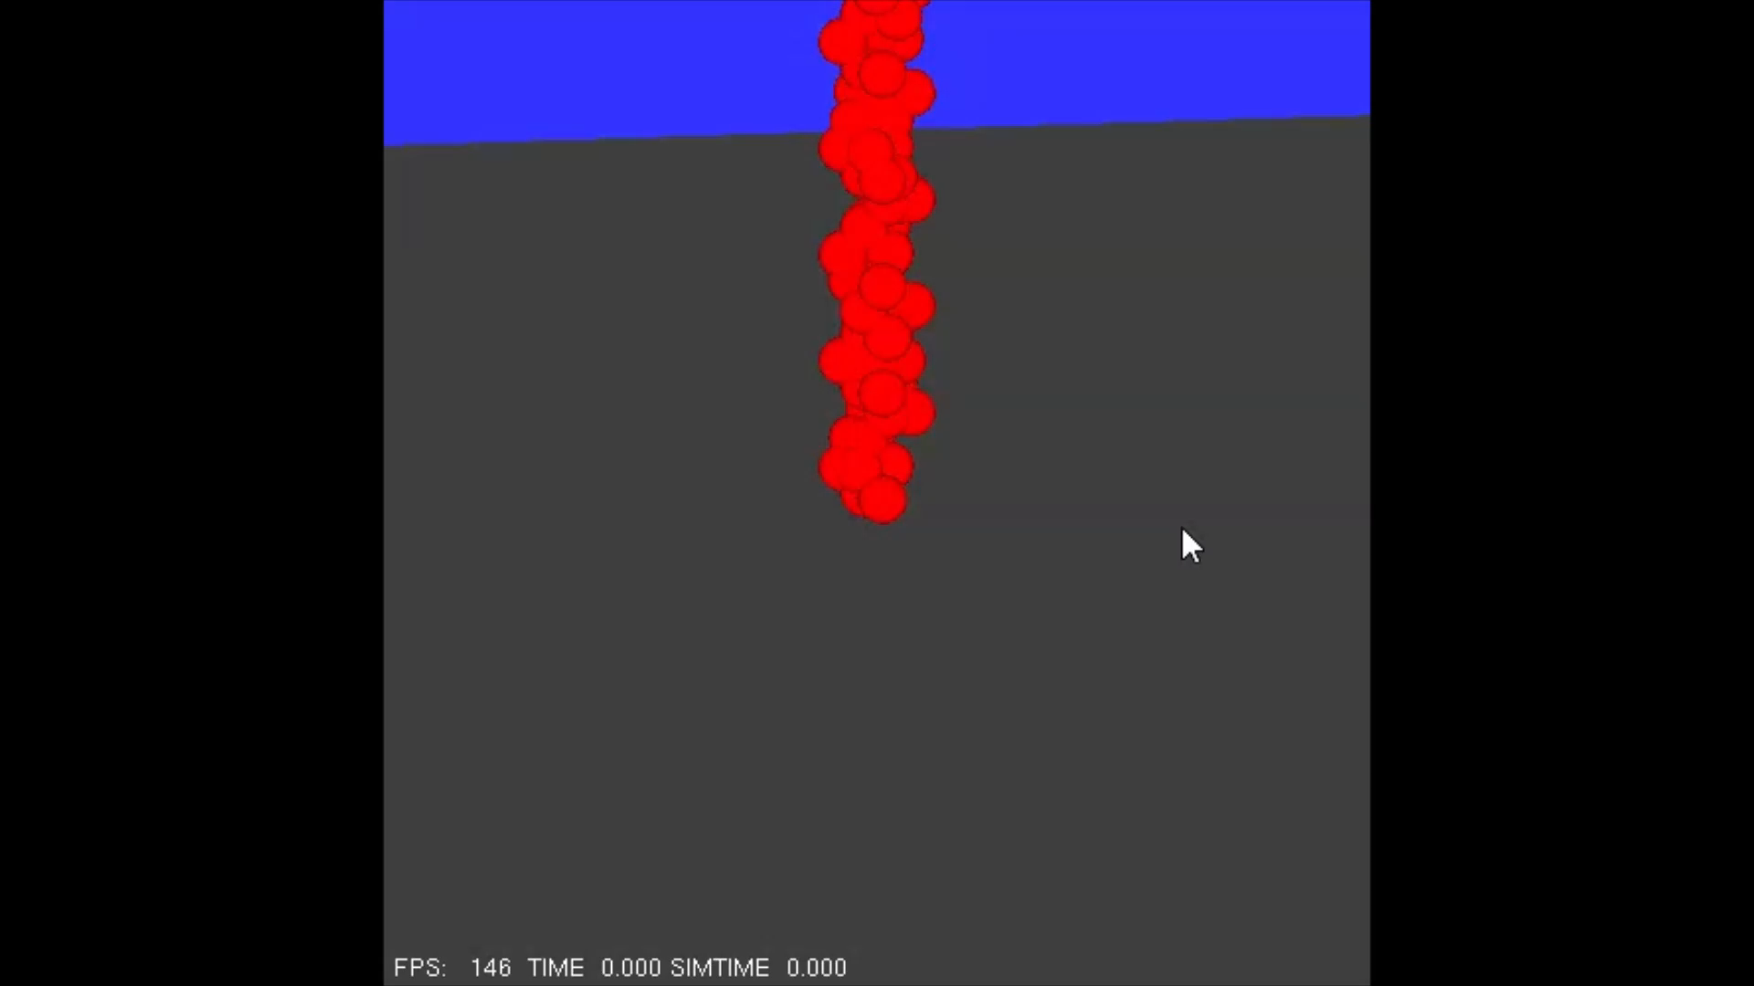
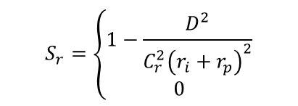
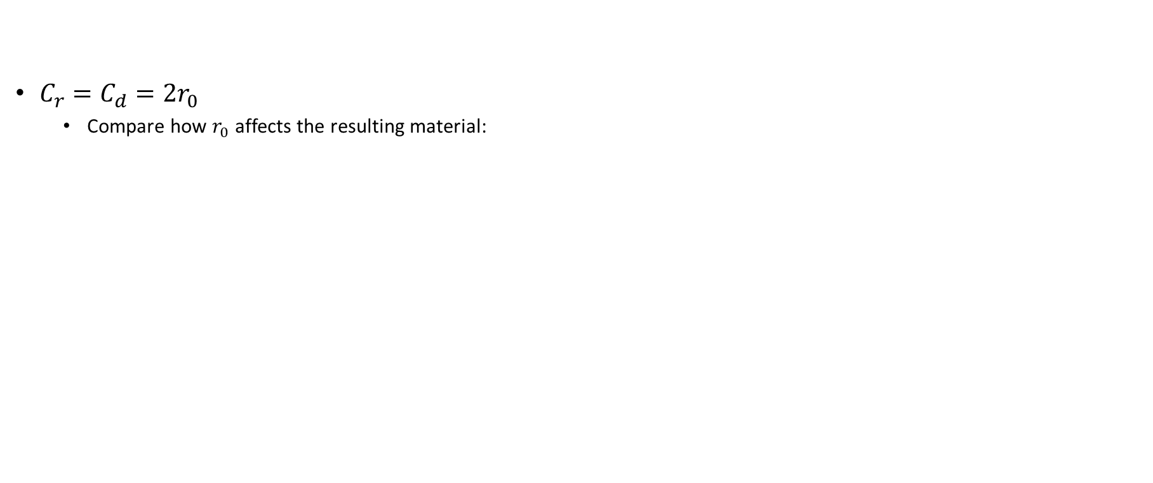
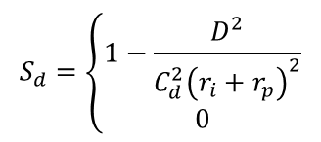
Solid
$$f_{ip}=\left\{\begin{aligned}{\overline{P}}_{∆}\left[S_{r}\left(\frac{b_{1}}{D^{m}}−\frac{b_{2}}{D^{n}}\right)−S_{d}\left(\frac{{\overline{V}}_{∆}⋅{\overline{P}}_{∆}}{D^{2}}\right)\right] if i≠p \\ 0\end{aligned}\right.$$
otherwise
$$S_{r}=\left\{\begin{aligned}1−\frac{D^{2}}{C_{r}^{2}{\left(r_{i}+r_{p}\right)}^{2}} \\ 0\end{aligned}\right.$$
$$S_{d}=\left\{\begin{aligned}1−\frac{D^{2}}{C_{d}^{2}{\left(r_{i}+r_{p}\right)}^{2}} \\ 0\end{aligned}\right.$$
$C_{r}=C_{d}=2r_{0}$
Compare how $r_{0}$ affects the resulting material:
otherwise
otherwise
r0 = 1
r0 = 2

Slide 8

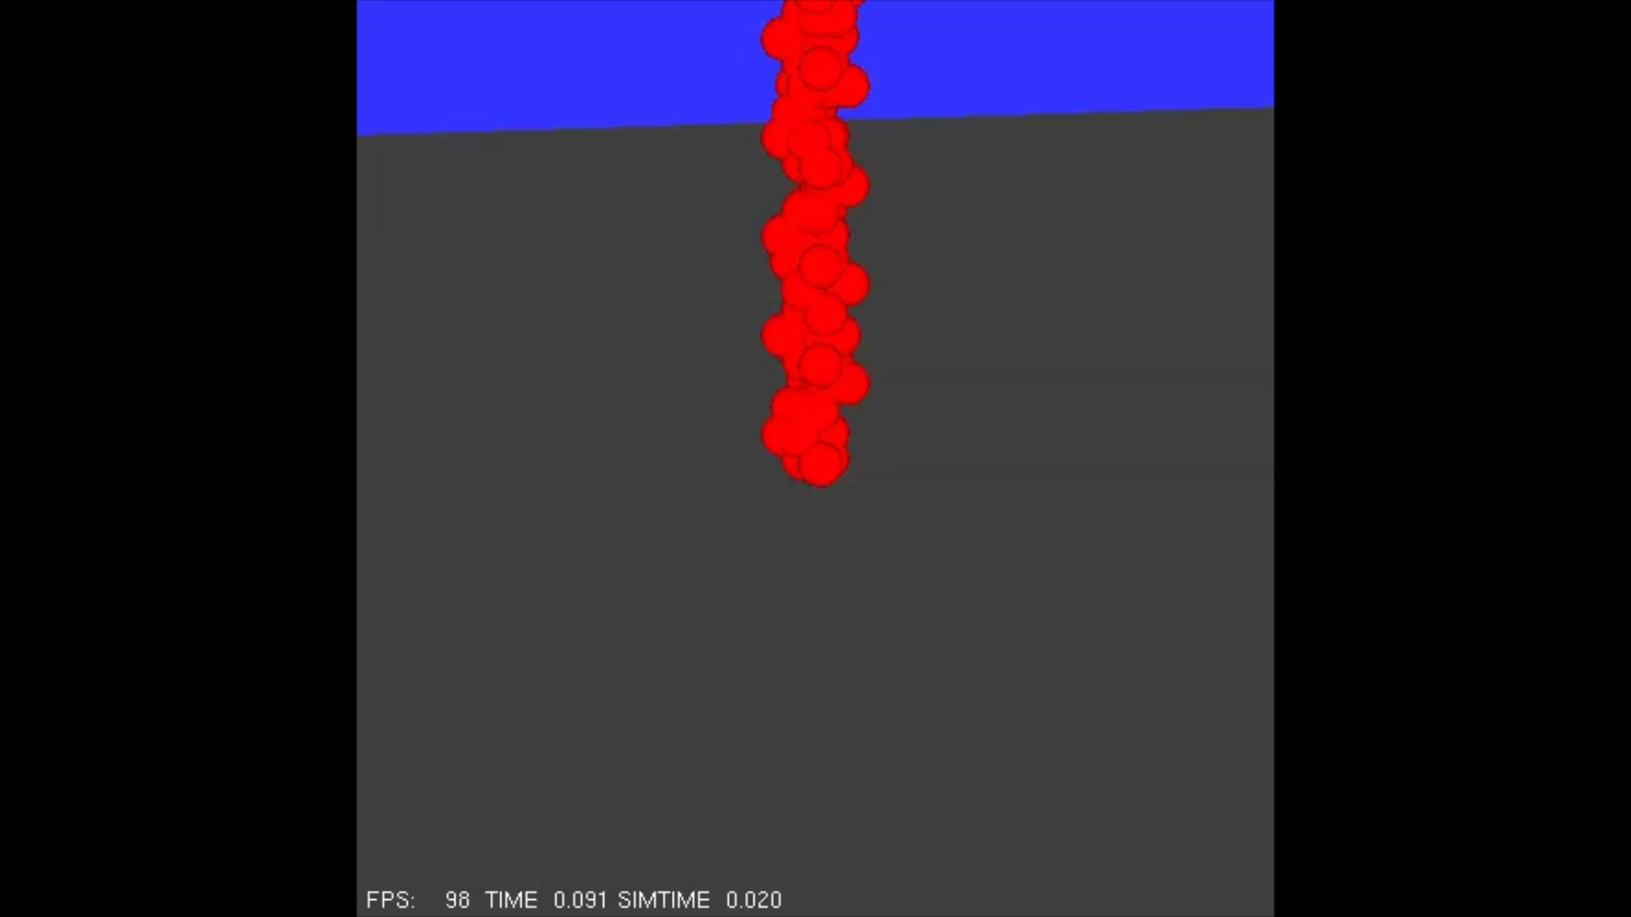
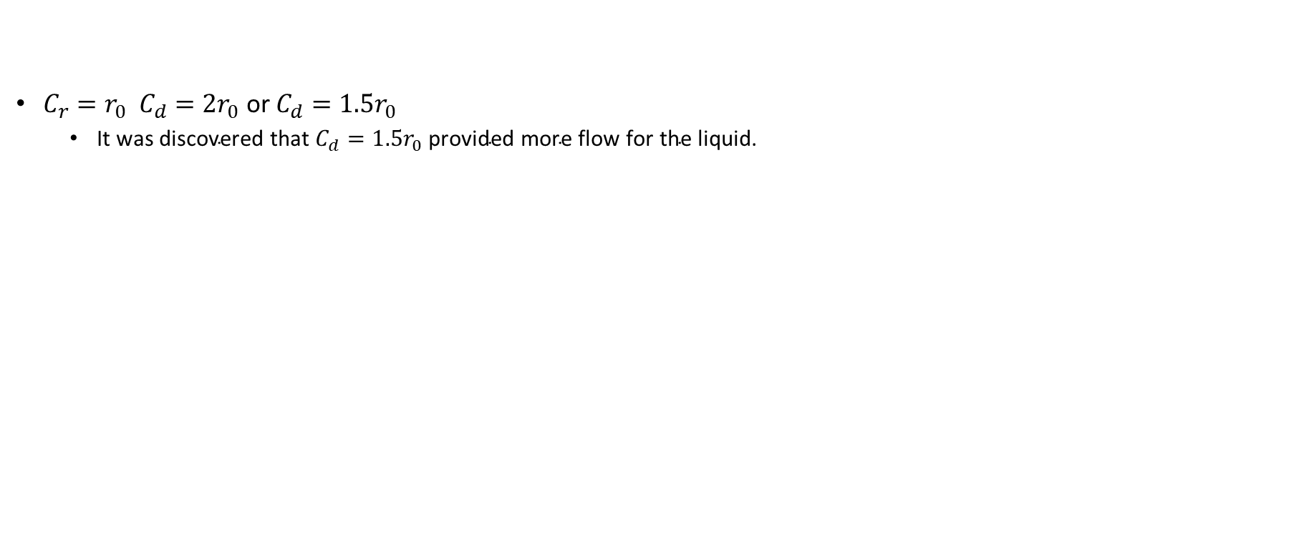
Liquid
$$f_{ip}=\left\{\begin{aligned}{\overline{P}}_{∆}\left[S_{r}\left(\frac{b_{1}}{D^{m}}−\frac{b_{2}}{D^{n}}\right)−S_{d}\left(\frac{{\overline{V}}_{∆}⋅{\overline{P}}_{∆}}{D^{2}}\right)\right] if i≠p \\ 0\end{aligned}\right.$$
otherwise
$$S_{r}=\left\{\begin{aligned}1−\frac{D^{2}}{C_{r}^{2}{\left(r_{i}+r_{p}\right)}^{2}} \\ 0\end{aligned}\right.$$
$$S_{d}=\left\{\begin{aligned}1−\frac{D^{2}}{C_{d}^{2}{\left(r_{i}+r_{p}\right)}^{2}} \\ 0\end{aligned}\right.$$
$C_{r}=r_{0} C_{d}={2r}_{0} \text{or} C_{d}={1.5r}_{0}$
$\text{It} \text{was} \text{discovered} \text{that} C_{d}={1.5r}_{0} \text{provided} \text{more} \text{flow} \text{for} \text{the} \text{liquid}\text{.}$
otherwise
otherwise
Cd = 2.0
Cd = 1.5

Slide 9
Challenges and Future Work
Globules overlap rigid bodies they collide with.
Fine for liquid spilling onto a ground plane,
Unacceptable for a thin container – apply an offset to the collision or increase size of container walls.
Euler integration requires a very slow timestep.
Future work should try higher order methods like Runge-Kutta or Semi-Lagrange.
Rendering <1000 globules is not ideal for large volumes of liquid.
Experiment with offloading work from CPU to GPU.
Temperature can be introduced to influence the type of material.
Freezing or smelting.

Slide 10

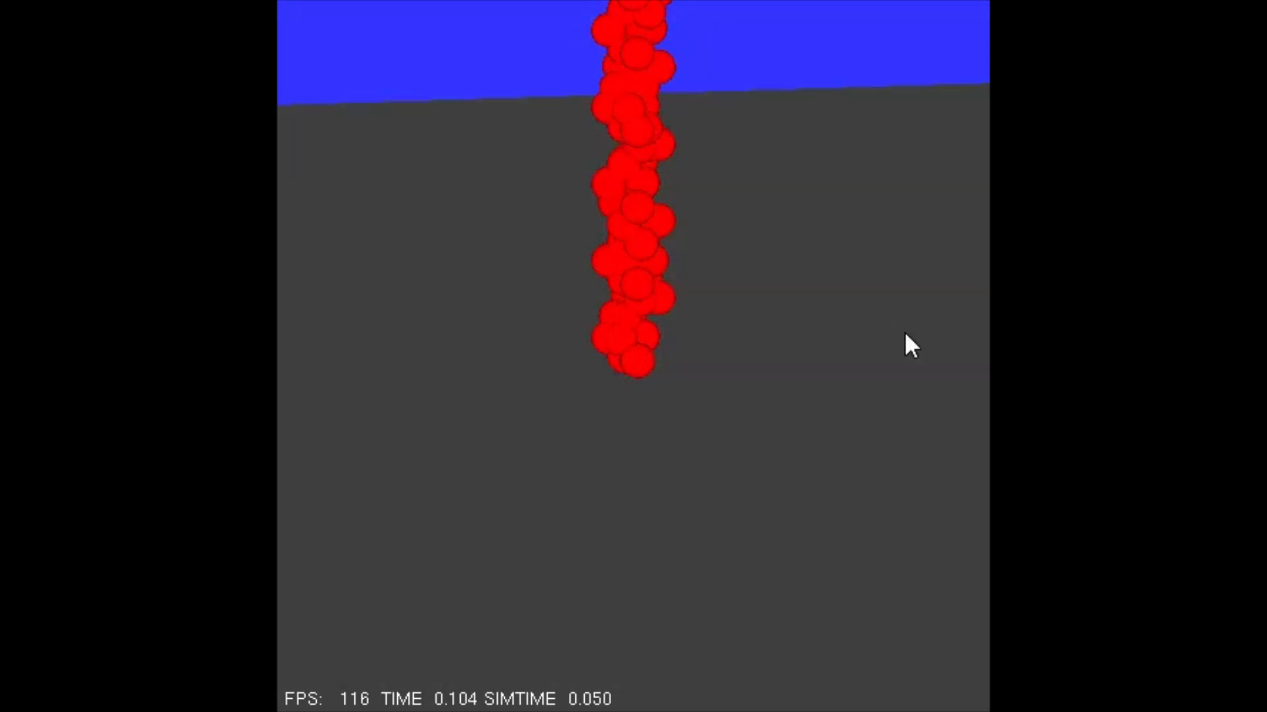

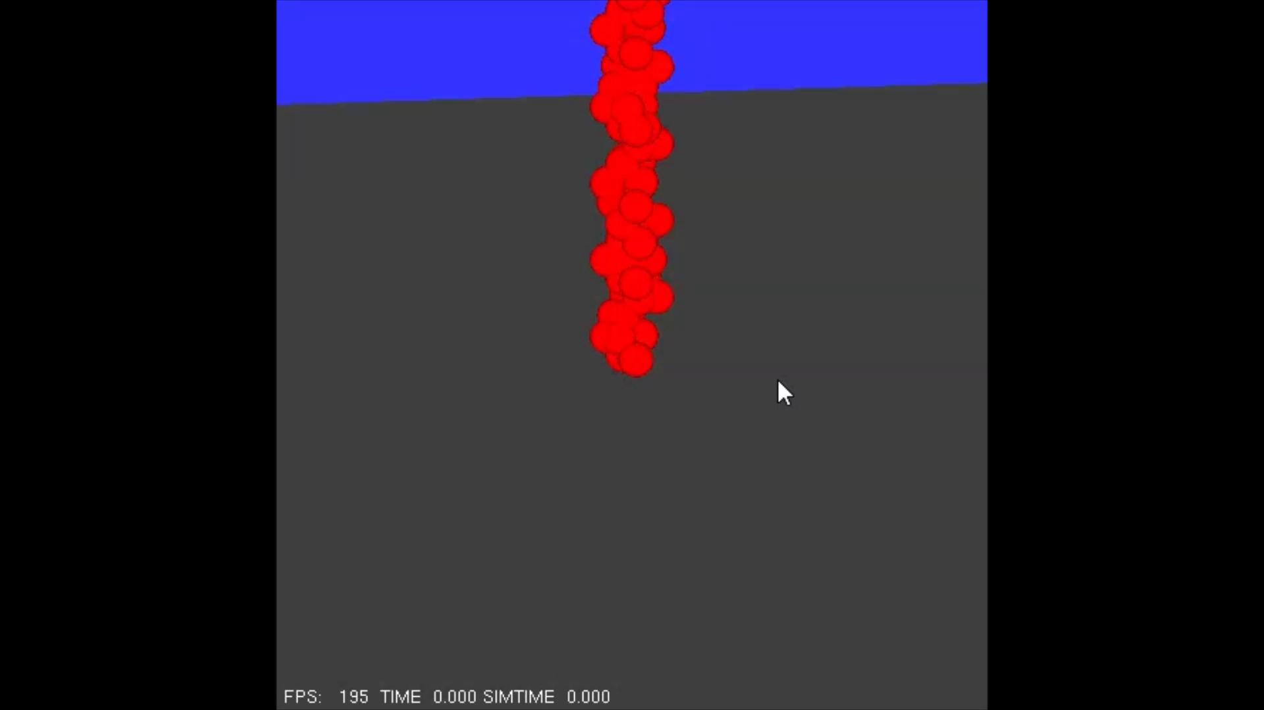

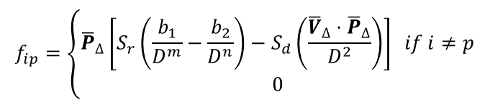
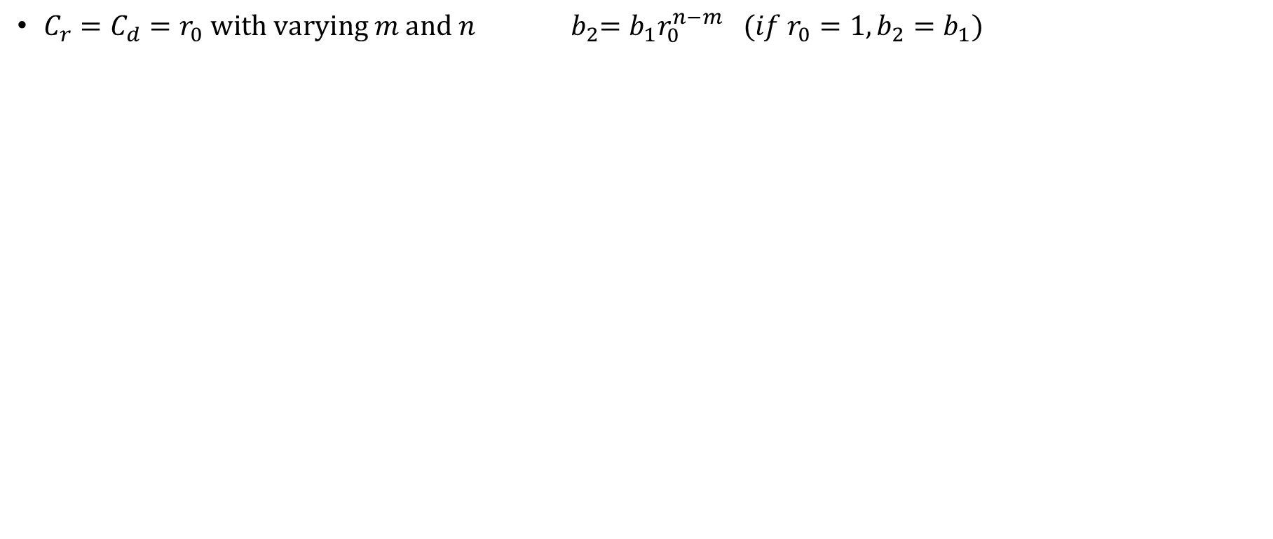
Extra Powder – m, n
$$f_{ip}=\left\{\begin{aligned}{\overline{P}}_{∆}\left[S_{r}\left(\frac{b_{1}}{D^{m}}−\frac{b_{2}}{D^{n}}\right)−S_{d}\left(\frac{{\overline{V}}_{∆}⋅{\overline{P}}_{∆}}{D^{2}}\right)\right] if i≠p \\ 0\end{aligned}\right.$$
otherwise
$C_{r}=C_{d}=r_{0} with varying m and n$ ${ b}_{2}=b_{1}r_{0}^{n−m} (if r_{0}=1, b_{2}=b_{1})$
Original
(m = 5
n = 3)
m = 6
n = 4
m = 7
n = 5
m = 4
n = 2
m = 5
n = 1

Slide 11


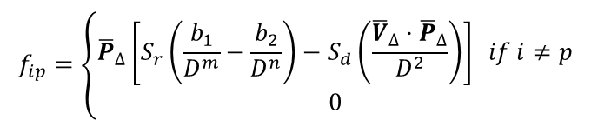
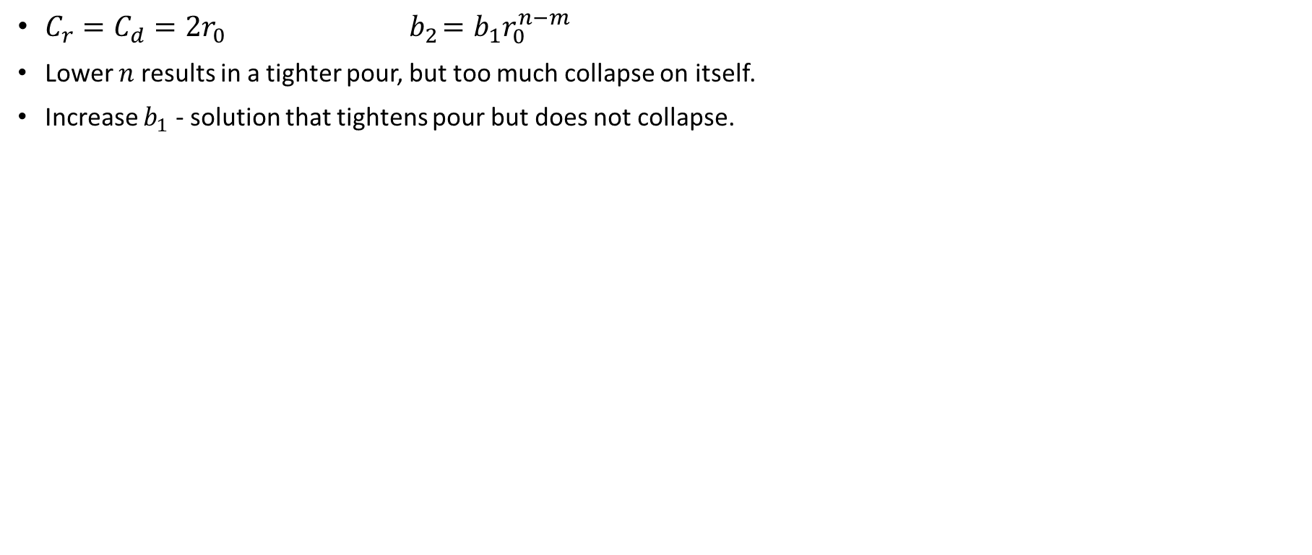
Extra Solid – Tight Pour
$$f_{ip}=\left\{\begin{aligned}{\overline{P}}_{∆}\left[S_{r}\left(\frac{b_{1}}{D^{m}}−\frac{b_{2}}{D^{n}}\right)−S_{d}\left(\frac{{\overline{V}}_{∆}⋅{\overline{P}}_{∆}}{D^{2}}\right)\right] if i≠p \\ 0\end{aligned}\right.$$
otherwise
$C_{r}=C_{d}=2r_{0}{ b}_{2}=b_{1}r_{0}^{n−m}$
Lower $n$ results in a tighter pour, but too much collapse on itself.
Increase $b_{1}$ - solution that tightens pour but does not collapse.
< n
> b1

Slide 12
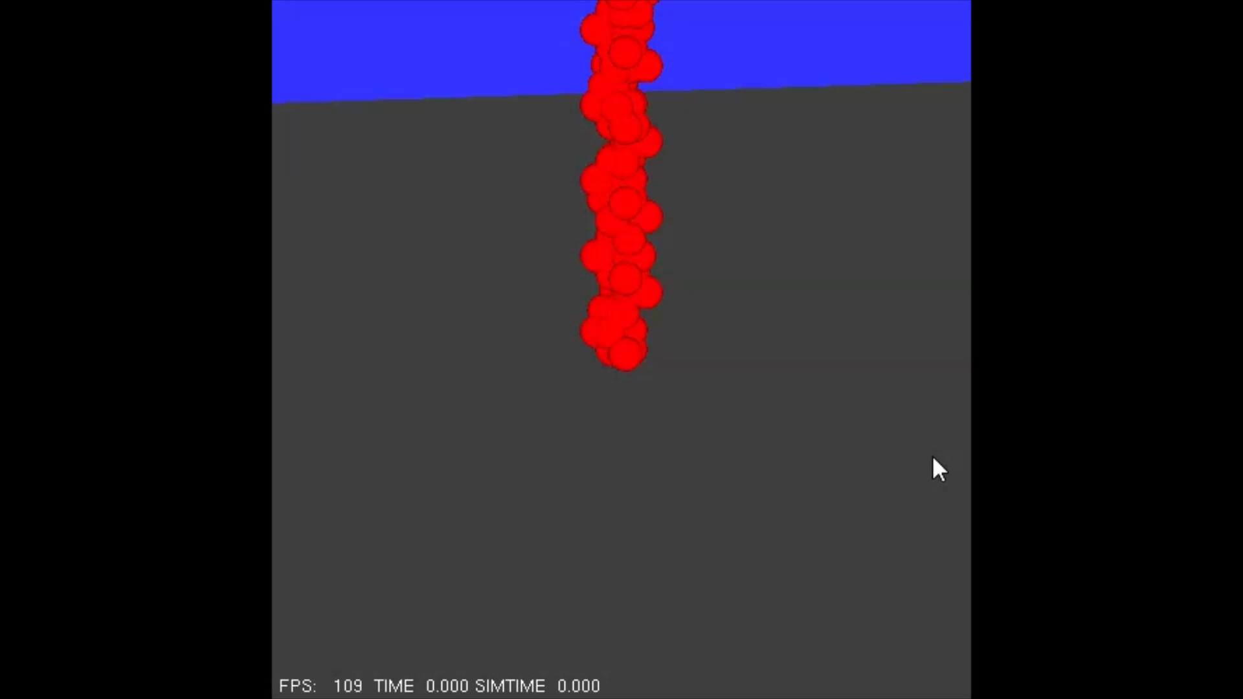
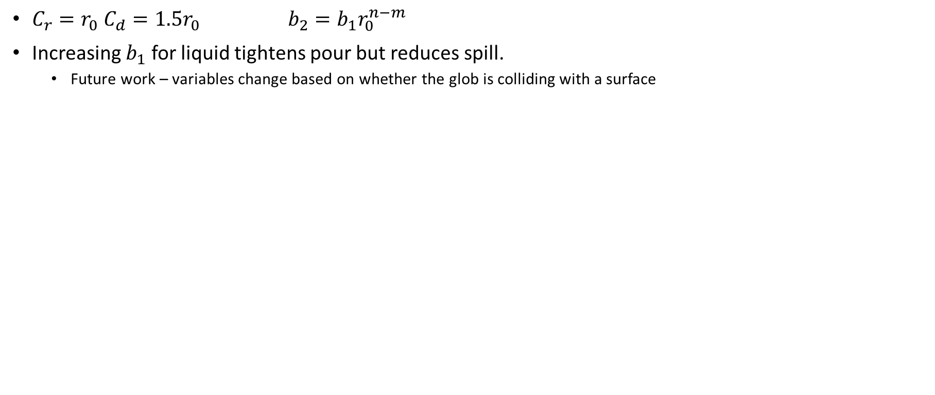
Extra Liquid – Tight Pour
$$f_{ip}=\left\{\begin{aligned}{\overline{P}}_{∆}\left[S_{r}\left(\frac{b_{1}}{D^{m}}−\frac{b_{2}}{D^{n}}\right)−S_{d}\left(\frac{{\overline{V}}_{∆}⋅{\overline{P}}_{∆}}{D^{2}}\right)\right] if i≠p \\ 0\end{aligned}\right.$$
otherwise
$C_{r}={r_{0} C}_{d}=1.5r_{0}$ $b_{2}=b_{1}r_{0}^{n−m}$
Increasing $b_{1}$ for liquid tightens pour but reduces spill.
Future work – variables change based on whether the glob is colliding with a surface
Tighter Pour
Original

Slide 13
References
Miller, G., Pearse, A. (1989). Globular dynamics: A connected particle system for animating viscous fluids. Computers & Graphics, 13(3), 305-309.
Reynolds, C. W., (1987). Flocks, herds, and schools: A distributed behavioral model. SIGGRAPH 87 Comp. Graphics 24(4), 20-26.
Some images used from slide deck made by:
Wyvill, B. “20-Globular Dynamics.” CSC 473: Fundamentals of Animation. CSC 473: Fundamentals of Animation, Victoria, B.C, University of Victoria.

Slide 14
Questions?

